Slide 1
EFFICIENT TRAVEL PLANNING MANAGEMENT SYSTEM USING RPA Team Members 1. Prakathi.P [711715104046] 2. Suvetha.S [711715104061] 3. Senthilnathan.J [711715104053]
Faculty Guide : Industrial Guide :
Dr.S.K.Mydhili Ms.Pavithra
Professor Team Associate
Department of CSE KGfSL

Slide 2
Agenda
Introduction
Objective
RPA Introduction
Literature survey
System Architecture
Uipath
Data Flow Diagram
Conclusion

Slide 3
Introduction
Many travel packages almost to all the places over the world are existing from different websites
For frequent travelers, they receive the ticket availabilities through mail notifications based on their frequent booking locations
It will be helpful for them to plan their travel accordingly
Robotic Processing Automation (RPA) is an emerging form of business process automation technology based on the notion of software robots or artificial intelligence workers

Slide 4
Objective & Expected Outcome
Objective
The objective of the project is to develop a system that automates the processes and activities of a travel agency
Expected Outcome
Users can decide about places they want to visit and make bookings online for travel and accommodation.

Slide 5
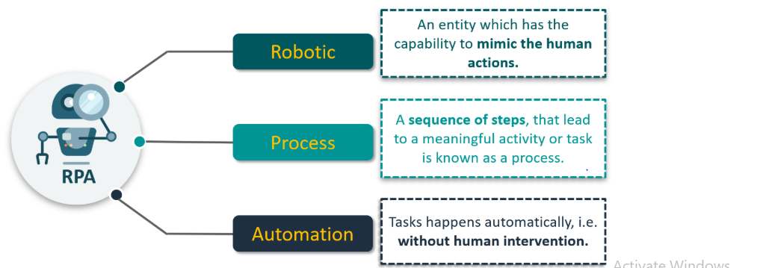

Slide 6
RPA- Introduction
RPA stands for Robotic Process Automation
The process of automating business operations with the help of robots to reduce human intervention is said to be Robotic Process Automation(RPA)
Robotic
-mimic human actions
process
-sequence of steps
Automation
-done by a robot without human intervention

Slide 7
ROLE OF RPA
Robotic Process Automation (RPA) emerging as software based solution to automate rules-based business processes that routine task, structured data and deterministic outcome
Recent studies report the benefit of the application of RPA in terms of productivity, costs, speed and error reduction
RPA stands for Robotic Process Automation is the application of technology that allows employees in a company to configure computer software or a “robot” to capture
Interpret existing applications for processing a transaction, manipulating data, triggering responses and communicating with other digital systems

Slide 8
UiPath
UiPath is a Robotic Process Automation tool which is used for Windows desktop automation
It is used to automate repetitive/redundant tasks and eliminates human intervention
The tool is simple to use and has a drag and drop functionality of activities
UiPath has a standard Studio version which has a trial period of 60 days
The best part is, UiPath also comes with a Community Edition which is free for lifetime and has most of the functionality of the Studio version

Slide 9
EXISTING SYSTEM
In the existing manual system of travel management, much time and money is wasted in reservation of bus or plane to destination, hotel at destination, etc.,
It involves a lot of manual paper works and the customers need to stay on queue for a long time
To root out such drawbacks of travel agencies, the whole system of management requires to be automated using computer and internet technology
Implemented in Android App using JAVA

Slide 10
PROPOSED SYSTEM
An attempt to overcome the drawbacks of the existing system, the whole system of management is automated using computer applications and internet technology
Implemented in RPA using Ui Path

Slide 11
Literature SURVEY
TITLE | YEAR | PUBLISHER | DESCRIPTION
Web and mobile based tourist travel guide system for fiji's tourism industry | 2014 | IEEE | The tourism sector is leading Fiji's Economy. There are limited technologies are used in this sector.
Developing a Creative Travel Management System Based on Software Reuse and Abstraction Techniques | 2017 | IEEE | Tourism became a common topic while the level of tourist requirements increased dramatically.

Slide 12
LITERATURE SURVEY
TITLE | PUBLICATION YEAR | PUBLISHER | DESCRIPTION
Travel management system using GPS & geo tagging | 2016 | IEEE | This application will also be used by travelling agencies to manage their customer trips, acquire information, etc
Travel Management System | 2017 | IEEE | The main objective of this project is to create a fast, effective and reliable.

Slide 13
LITERATURE SURVEY
TITLE | PUBLICATION YEAR | PUBLISHER | DESCRIPTION
Travel Planner | 2016 | IEEE | Most traveler need to plan prior their traveling for energy saving and visiting maximum places of interest within the specific travel time.
Augmented Reality Based Mobile Travel Guide System | 2015 | IEEE | There is greatly enriched travel information provided to the tourists on the Internet.

Slide 14
Architecture diagram-Overview
.
Database
User
RPA
Admin

Slide 15
Flowchart
Start
Ticket avabile
Book ticket
Personal details
Payment
Yes/no
Ticket details
Cancel
Refund

Slide 16
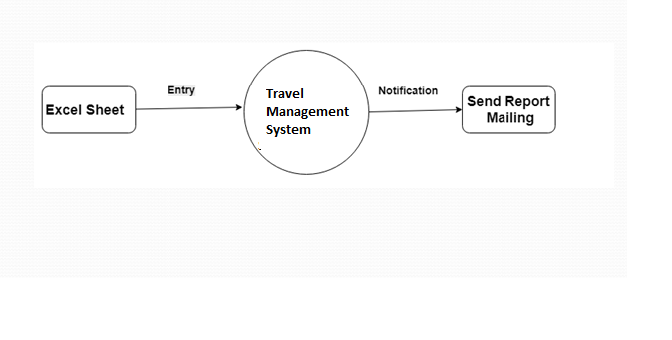
Data Flow Diagram Level 0

Slide 17
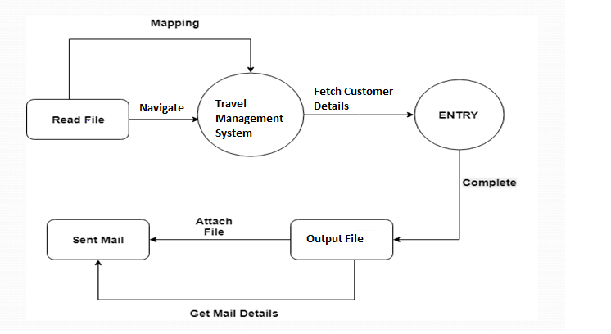
Data Flow Diagram Level 1

Slide 18
Module Split up
Designing the Web page for Travel management system
Mapping filename with the site data
Data entry
Reporting and sending the mail

Slide 19
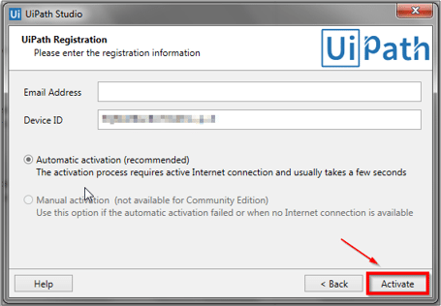
Screenshots- Ui Path

Slide 20
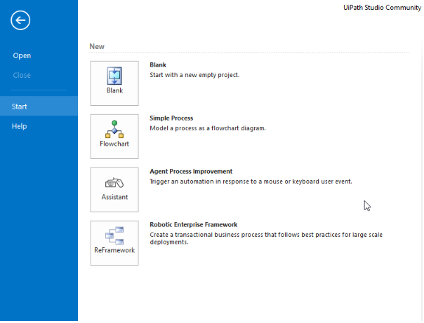
Screenshot- Ui Path Studio Level 0

Slide 21
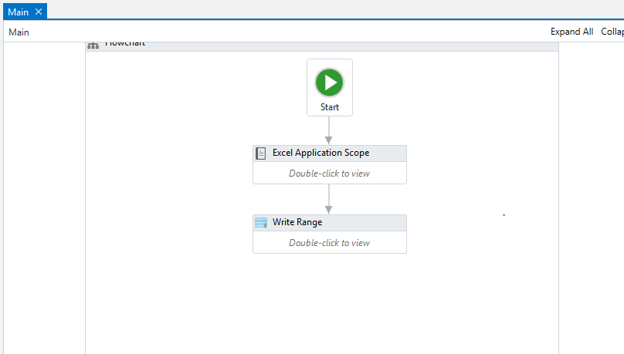
Screenshot- Ui Path Studio Level 1

Slide 22
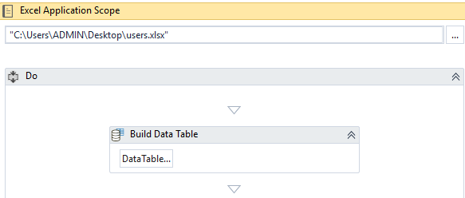
Screenshot- Ui Path Studio Level 2

Slide 23
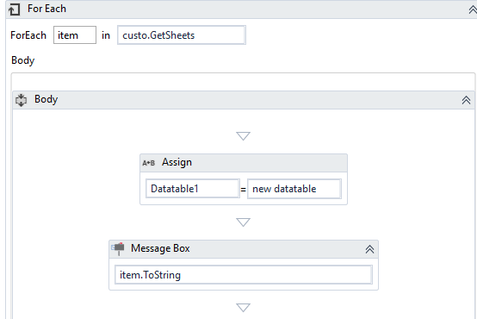
Screenshot- Ui Path Studio Level 3

Slide 24
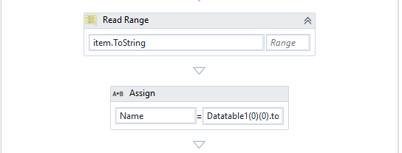
Screenshot- Ui Path Studio Level 4

Slide 25
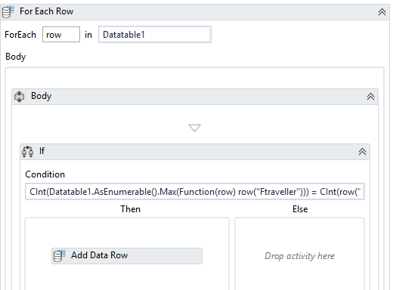
Screenshot- Ui Path Studio Level 5

Slide 26
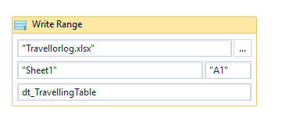
Screenshot- Ui Path Studio Level 6

Slide 27
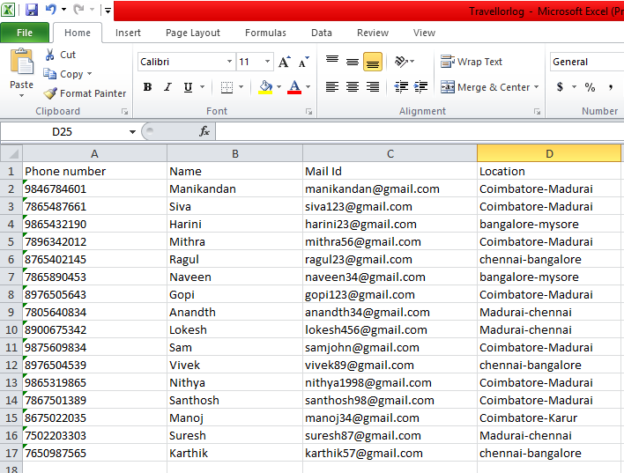
Backend Excel sheet

Slide 28
Proposed System
Advantages over existing method - There should be system where the customer should find the best package through mail notification with a single click - Using a ‘drag and drop’ method you can shape and create a workflow that is easy to understand
Disadvantage
The drawbacks of existing methods , - Network traffic - Process is not applicable to all - Not in offline process

Slide 29
CONCLUSION
to computerize the different operations in travel agencies
is very flexible and secured
admins can incorporate new features and manage the modules of the system as per the requirements
being a web-based software, it can be accessed from anywhere with internet

Slide 30
Future Enhancements
Implementation of notification processing through message in upcoming years

Slide 31
Reference [1]Sicong Ma ; Hongji Yang ; Meiyu Shi,"Developing a Creative Travel Management System Based on Software Reuse and Abstraction Techniques", IEEE 41st Annual Computer Software and Applications Conference (COMPSAC), IEEE Xplore September 2017. [2] Vineet Singh ; Akeshnil Bali ; Avinesh Adhikthikar ; Rohitash Chandra,"Web and mobile based tourist travel guide system for fiji's tourism industry",Asia-Pacific World Congress on Computer Science and Engineering,IEEE March 2015. [3]CameliaLemnaru,MioaraDobrin,MihaelaFlorea,RodicaPotolea “Designing a Travel Recommendation System using Case-Based Reasoning and Domain Ontology”, 8th International Conference on Intelligent Computer Communication and Processing,IEEE Digital Explore- 2012. [4] Ying Xu, Tao Hu, Ying Li, “A Travel Route Recommendation Algorithm withPersonal Preference”, 12th International Conference on Natural Computation, Fuzzy Systems and Knowledge Discovery (ICNC-FSKD), IEEE Digital Explore, 2016 . [5] Amrah Maryam ; Nadia Siddiqui ; Mohammed A. Qadeer ; M. Sarosh Umar,"Travel management system using GPS & geo tagging on Android platform",Thirteenth International Conference on Wireless and Optical Communications Networks (WOCN),IEEE Xplore dec 2016. [6]Vineet Singh School of Computing Science, Information System and Mathematics, The University of the South Pacific, Lauca Bay, Suva, Fiji [7]Akeshnil Bali School of Computing Science, Information System and Mathematics, The University of the South Pacific, Laucala Bay, Suva, Fiji [8]Avinesh Adhikthikar School of Computing Science, Information System and Mathematics, The University of the South Pacific, Laucala Bay, Suva, Fiji

Slide 32
[9]Rohitash Chandra School of Computing Science, Information System and MathematicMethodological Considerations", in: Proceedings of 2003 International Conference on Management of e-Commerce and e-Government Jangxi Science and Technology Press, pp. 416-421, 2003.
[10] H. Nwana, D. Ndumu, "A perspective on software agents research", The Knowledge Engineering Review, vol. 14, no. 2, pp.. [11]D. Ndumu, J. Collins, H. Nwana, "Towards Desktop Personal Travel Agents", BT s, The University of the South Pacific, Laucala Bay, Suva, Fiji Citation Map April 2013.
[12]B. Brown, M. Chalmers, "Tourism and mobile technology", pp. 339, 2003. [13] M. Gordon, M. Paprzycki, "Designing Agent Based Travel Support System". G. M, P. M., "Designing Agent Based Travel Support System", Parallel and Distributed Computing, 2005. [14] P. Maes, "Agents that Reduce Work and Information Overload", Communications of the ACM, vol. 37, no. 7, pp. 31-40, 1994. [15] M. Paprzycki, A. Abraham, "Agent Systems Today; Technological Journal, vol. 16, no. 3, pp. 69-78, 1998. Travel Market: Real-Life Application of the FIPA Standards", Technical Report BT Project AC317, 1999.

Slide 33
Thank You!!!

